Slide 1
Housing Price Analysis

Slide 2
Purpose
To analyse and predict house price based on multiple factors such as Year, Mortgage rate, Immigration, and Region

Slide 3
Data Source
HPI Data: A monthly seasonally adjusted housing prices showing composite HPI and Composite Benchmark was extracted from CMHC (Canada Mortgage and Housing Corporation) from January 2005 to September 2022
Mortgage Data: A dataset showing monthly mortgage rate from 1951 - 2022 was collected from Kaggle.com.
Immigrants Data: Quarterly information on immigrants was extracted from Statistics Canada.

Slide 4
Tools and Technology
Preprocessing Data : Python, Pandas
DataBase : PostgreSQL, SQLAlchemy
Machine Learning: Python - pandas, sklearn, train_test_split, matplotlib
Visualisation: Plotly, json, Javascript, HTML
Presentation: Google Slides

Slide 5
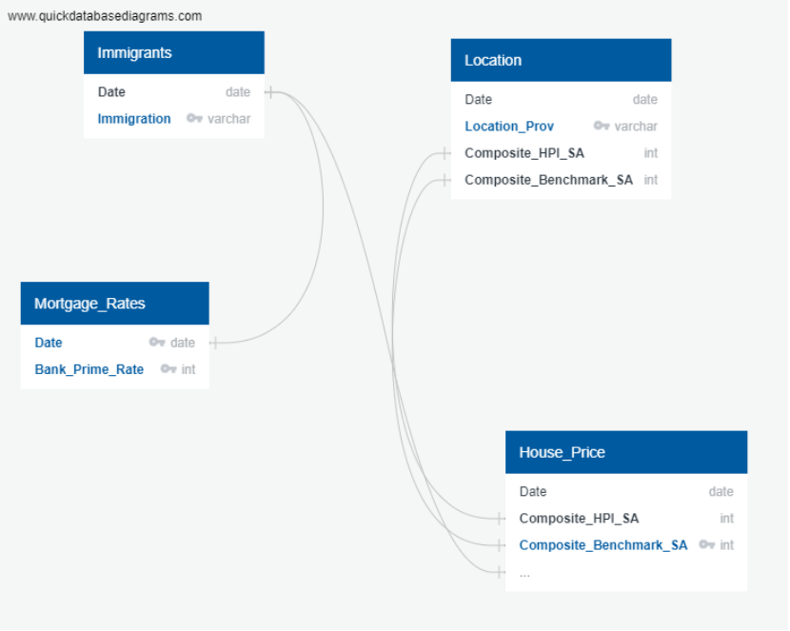
Quick Database Diagram

Slide 6
Data Preprocessing
Exploratory Data analysis was conducted on three csv tables
Null value, datatypes and summary of the data type for three data frames were accessed
Unnecessary columns were removed from the HPI file as we wanted just composite prices
For all the 3 csv files Date needed to be changed to datetime format and Immigrants data which was quarterly, was changed to monthly by dividing the quarterly figure into 3 equal parts
Only the month and year was kept as the dates needed to be consistent with all the files
Three tables were imported to SQL with the help of connection string using SQLAlchemy
The final database was created with the use of Join statement and finally the database were imported from SQL to pandas using connection string to deploy it to machine learning model

Slide 7
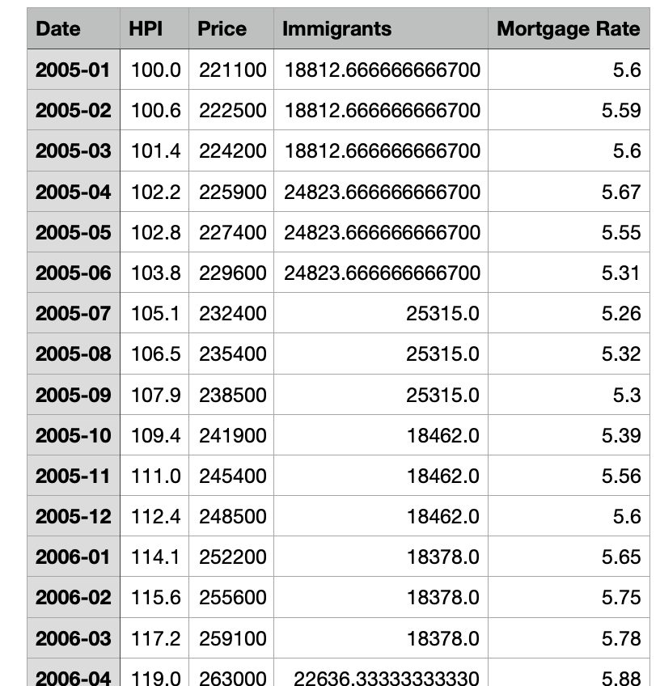
Final Database
Merged Data showing Composite HPI, Mortgage Rate, Immigrants, and Year

Slide 8
Machine Learning Model
Preliminary data processing
Date column was changed to ordinal
HPI column was dropped
Feature Selection
Target variable: Price
Features: rate, immigrants, date
Training and Testing split
Data were split into train and test size in the ratio of 80:20

Slide 9
Model Choice
Linear Regression Model is used as we are predicting house price based on a combination of input variables like interest rate, immigrant population.
Benefit
The model is easier to implement, easier to train and interpret
It helps to find the nature of relationship among the variables
Drawback
The model is prone to overfitting
It assumes linear relation between dependent and independent variable thus can over simplify real world problems
Linear Regression Model was run and following are the results from the Model
R-squared: 0.94358
Mean squared error: 745478395.75

Slide 10
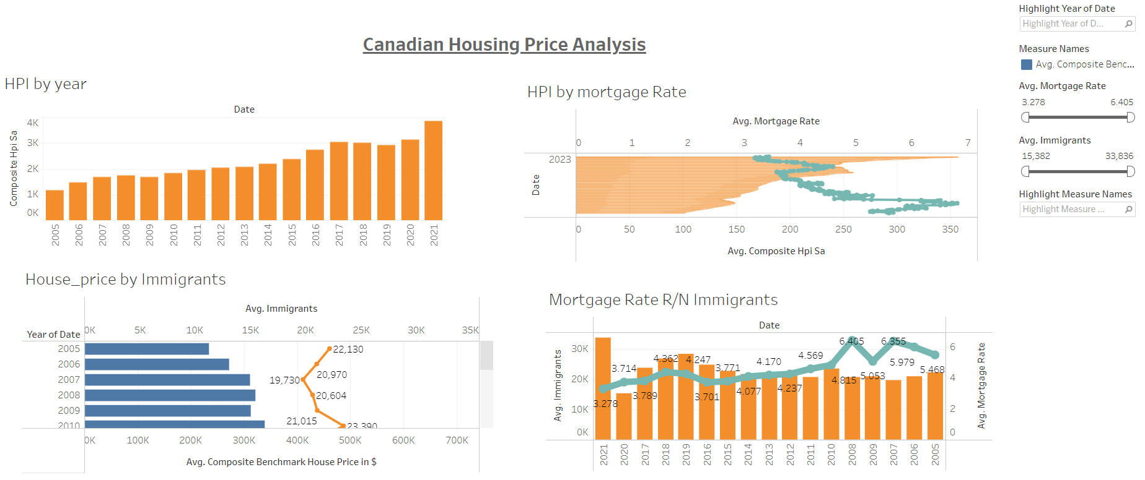
Visualisation Results
Tableau Dashboard created to show results from the merged data.

Slide 11
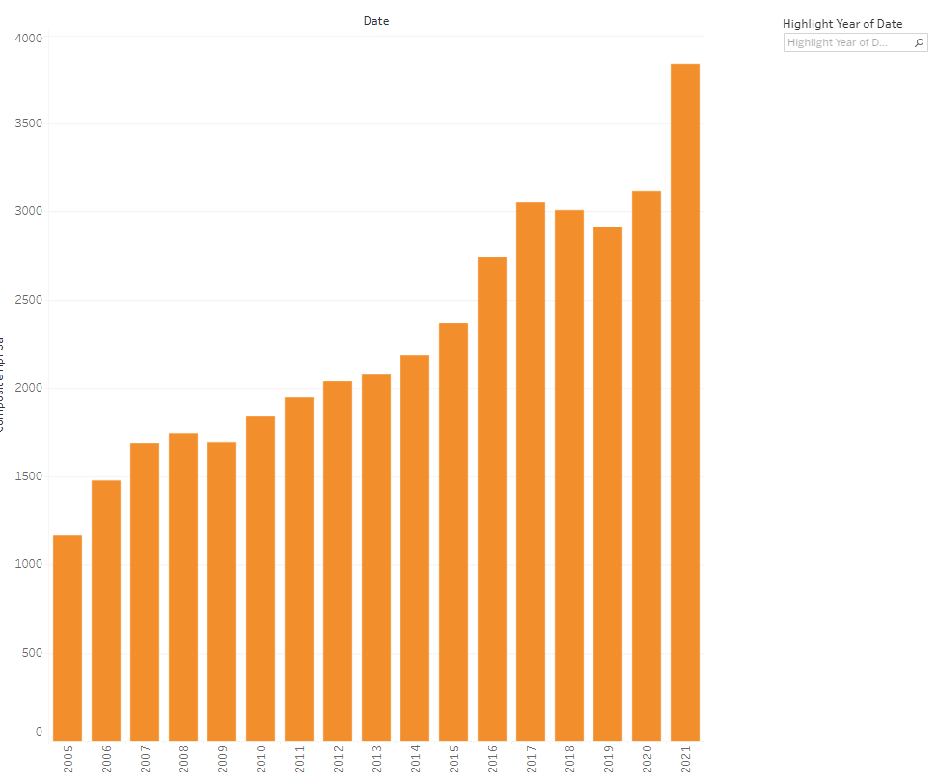
Results: Chart showing Composite Housing

Slide 12
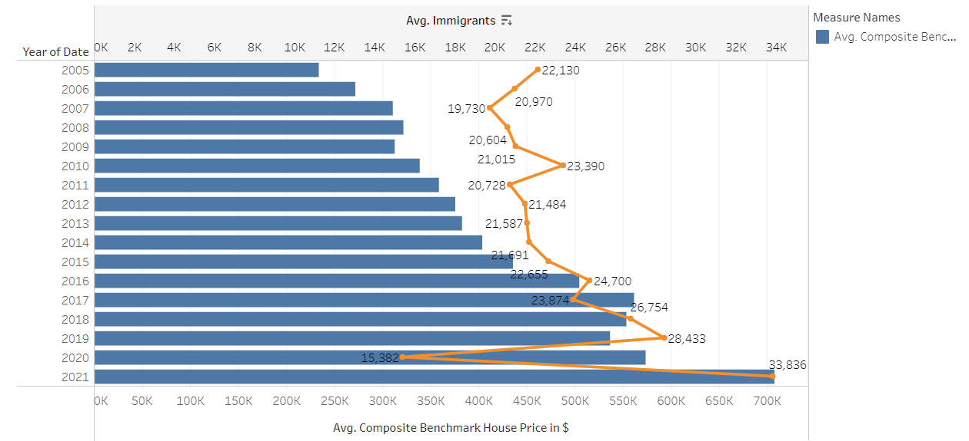
Chart showing Housing prices vs Immigration

Slide 13
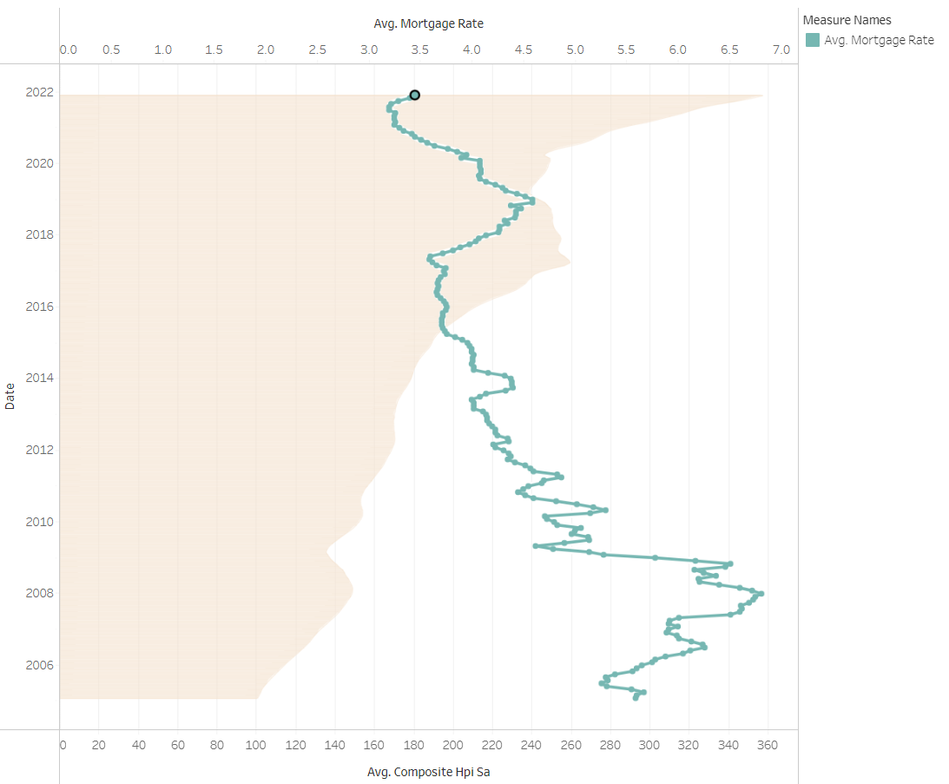
Chart showing housing price fluctuations based on Mortgage rate

Slide 14
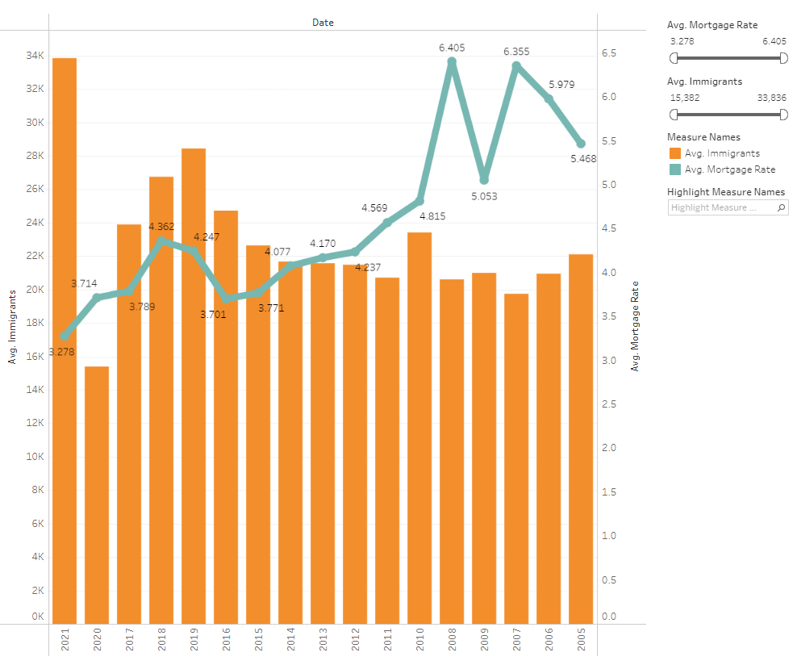
Chart showing impact of Mortgage Rate, Immigrants, and Year on Housing Prices

Slide 15
Final Dashboard
Final visualization dashboard will be created using Javascript and Plotly.JS a Javascript data visualization library

Slide 16
Recommendations

Slide 17
Questions

